Slide 1
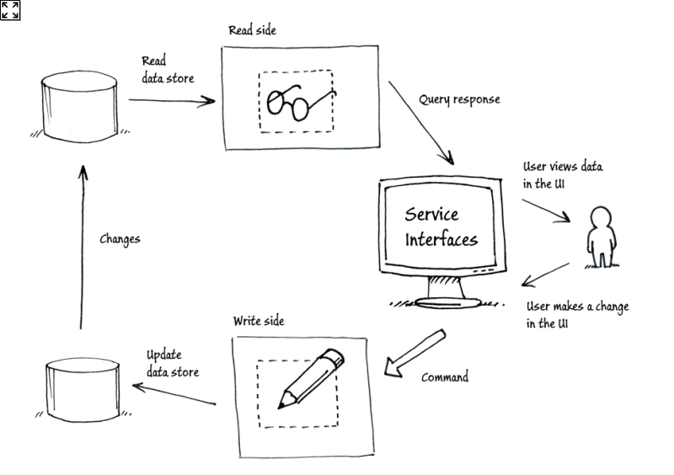

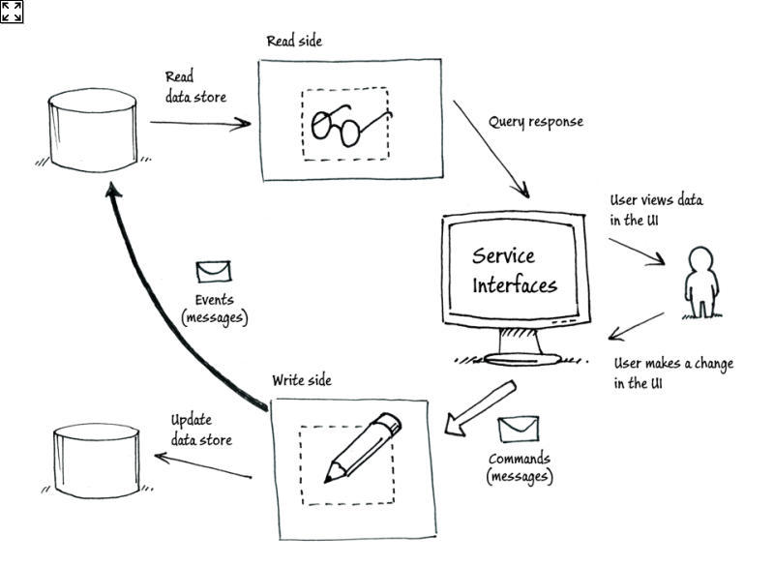

CQRS in a nutshell
« ready-to-eat data », Caches, non-normalized models, (no SQL)
Classical transactional databases RDBMS (ACID)

